Slide 1
DISPENSE COLUMN LEAKAGE
22-03-2019

Slide 2
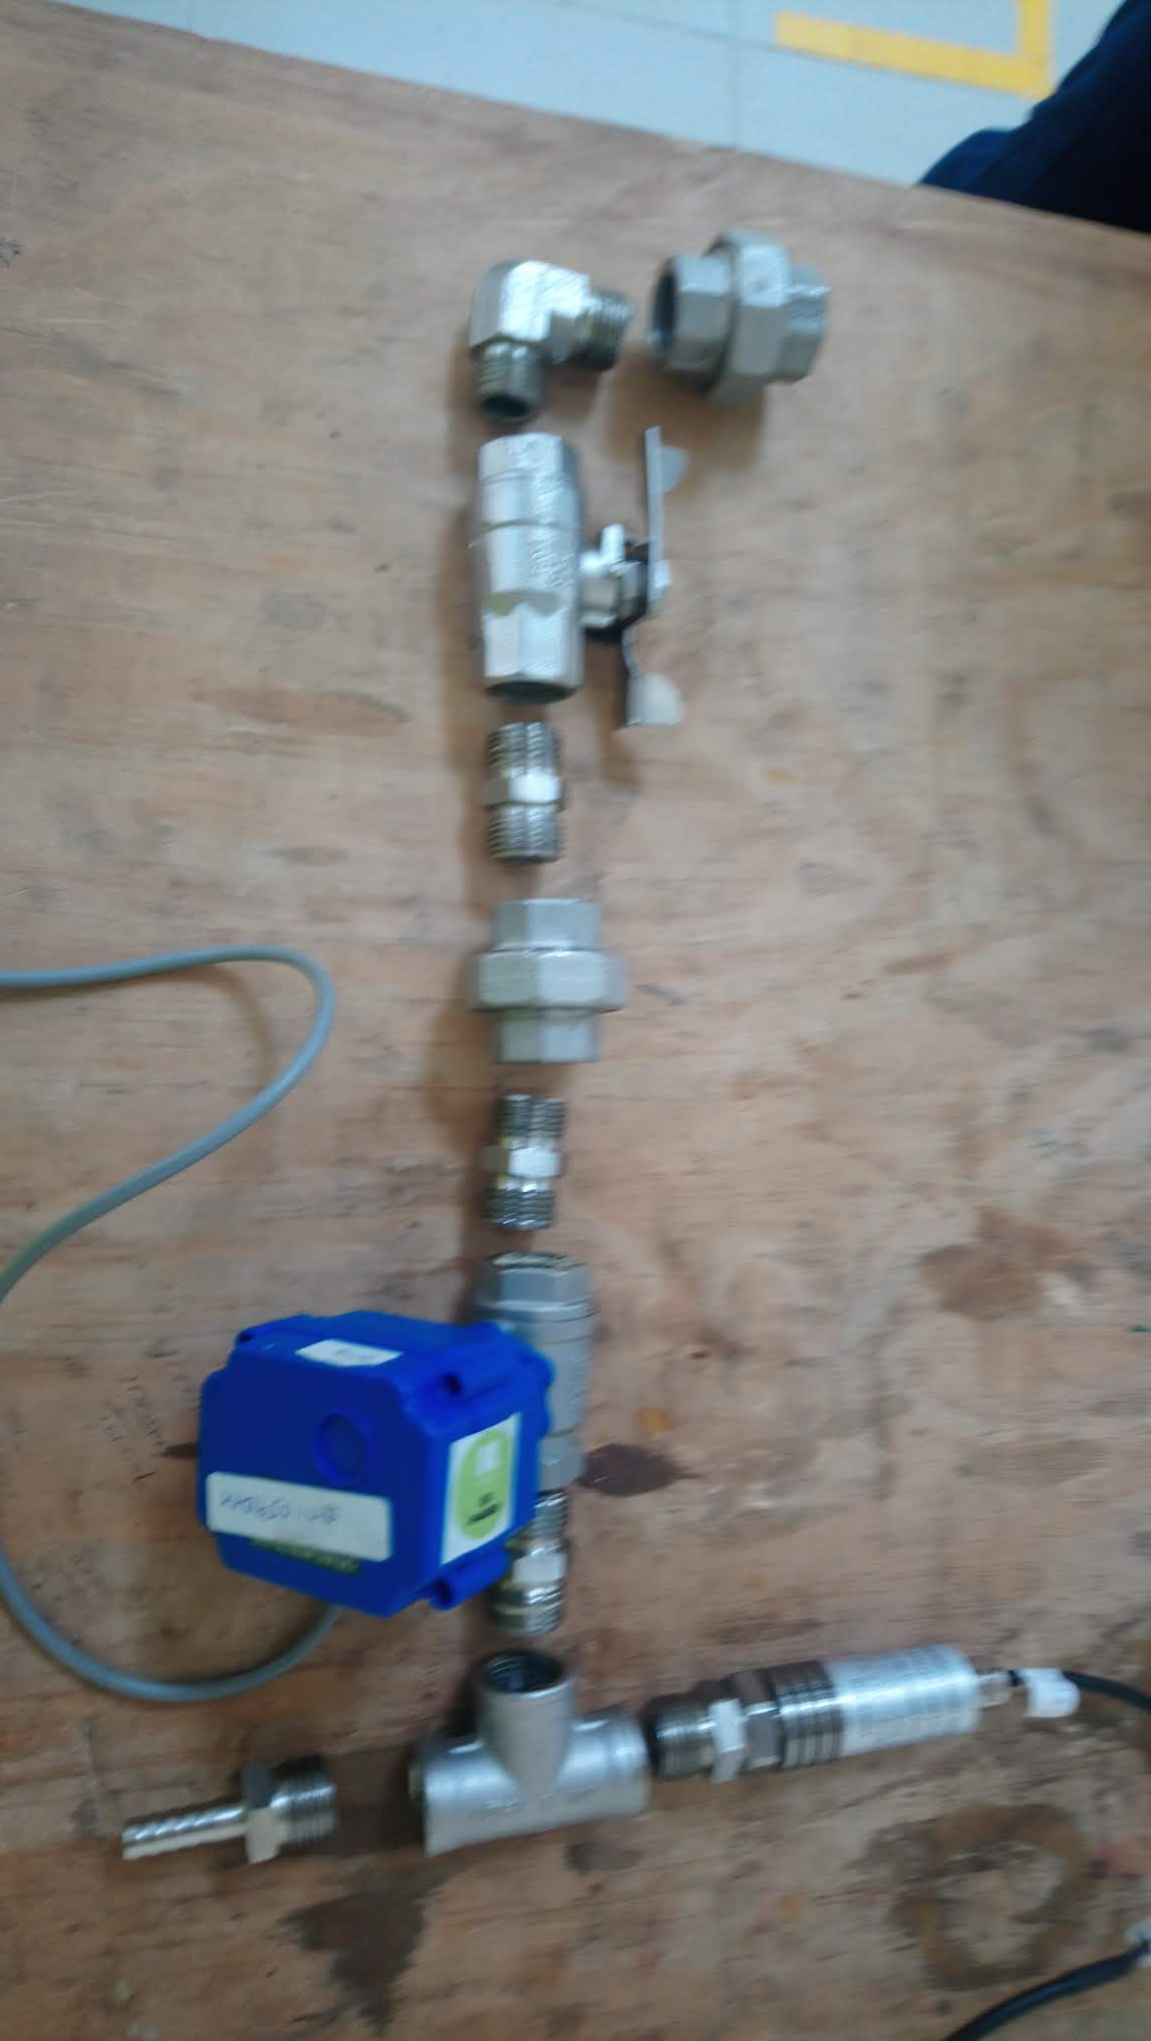
DISPENSE COLUMN LEAKAGE POINTS EXPLODED VIEW
THREE PIECE UNION
ELBOW
MANUAL VALVE
Leakage Video
NIPPLE
THREE PIECE UNION
NIPPLE
FEMALE TEE

Slide 3
PART SERIAL | STATUS | REASON FOR FAILURE
KA36S0014 | PASS
KA36S0134 | FAIL | Leakage between three piece union and nipple
KA36S0152 | FAIL | Leakage between three piece union and female tee AND between Female tee and Manual Valve
KA36S0112 | FAIL | Leakage between three piece union and female tee
KA36S0100 | FAIL | Leakage between three piece union and nipple
KA36S0143 | FAIL | Leakage between three piece union and female tee AND between Female tee and Manual Valve
KA36S0001 | PASS
KA36S0010 | FAIL | Leakage between Female tee and Manual Valve
KA36S0004 | FAIL | Leakage between Female tee and Manual Valve
KA36S0020 | PASS
KA36S0050 | FAIL | Leakage between three piece union and nipple
KA36S0006 | PASS
KA36S0003 | PASS
KA36S0144 | FAIL | Leakage between three piece union and female tee AND between Female tee and Manual Valve
KA36S0079 | FAIL | Leakage between MBV, Three piece union to nipple
KA36S0022 | FAIL | Leakage between three piece union and nipple
KA36S0045 | FAIL | Leakage between three piece union and nipple
KA36S0074 | FAIL | Leakage between three piece union and nipple

Slide 4
Tests Ongoing
Test rig has been built to carry out the leakage test
3 dispense columns have been reworked(increase the amount of loctite) to be QCd on Monday 25/03/19
1 assembly redone with local union piece where leaks are occurring frequently which has a different thread pitch previous used by our maintenance crew:QC checks for same will be done on monday after drying of the loctite
The fourth one we have redone using thread tape also to be tested on monday 25/03/19
All test are done to be ascertain the root cause

Slide 5
QC REPORT 25.3.18

